Slide 1
Dataset from Visser et al (2013)

Slide 2
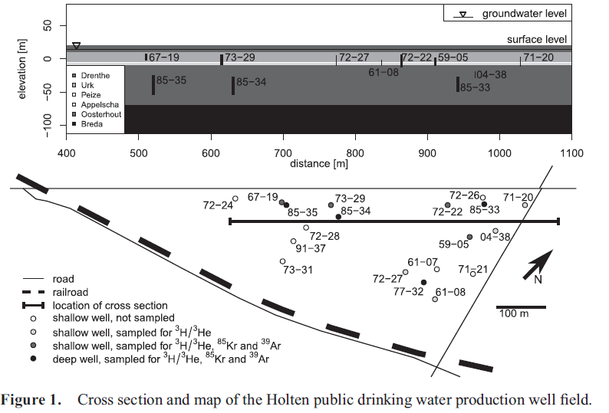
Dataset: sampling locations and dates
7 pumping wells
Sampling in 2010

Slide 3
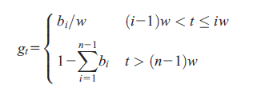
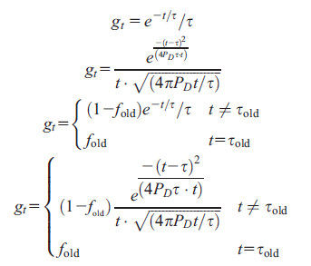
Dataset: shape of the calibrated RTDs
5 RTD equations: 1 shape-free and 4 analytical models
3, 4, 5, and 9 bins of equal width
3: 2 bins young (width of 30 years) + 1 bin old
4: 3 bins young (width of 20 years) + 1 bin old
5: 4 bins young (width of 15 years) + 1 bin old
9: 8 bins young (width of 7.5 years) + 1 bin old
Exponential: 1 parameter
Dispersion: 2 parameters
Exponential + old: 2 parameters
Dispersion + old: 3 parameters
1950-2010
Water recharged before 1950

Slide 4
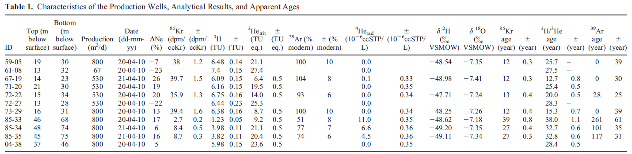
Dataset: tracers data
3 tracers: 85Kr, 3H/3He, and 39Ar (file sampling_data.txt)
1Bp = 60dpm
1Bq/m3 = 6x10⁻⁵ dpm/cc

Slide 5
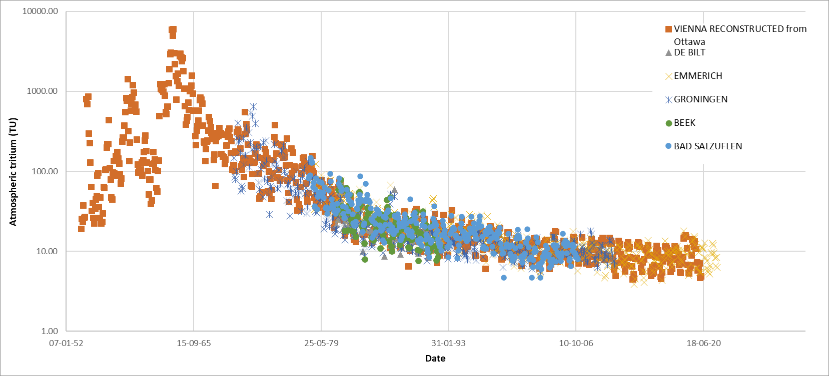
Dataset: input sources
3H : reconstructed locally from 5 stations (weighted linear slope to Vienna)

Slide 6
Dataset: input sources
Radiogenic 3He is insignificant (determined from 4He radiogenic)
³He is mainly tritiogenic
Initial 3H =3H measured​+3He tritiogenic​
For very old water (in monitoring wells) 3H measured is close to 0, they estimate premodern 3H = 3 TU

Slide 7
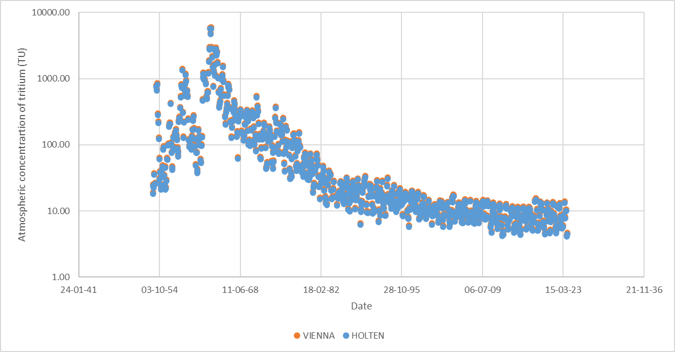
Dataset: input sources
Reconstructed 3H
Prior to 1953: 3TU
> 1953: (file local_tritium.txt)

Slide 8
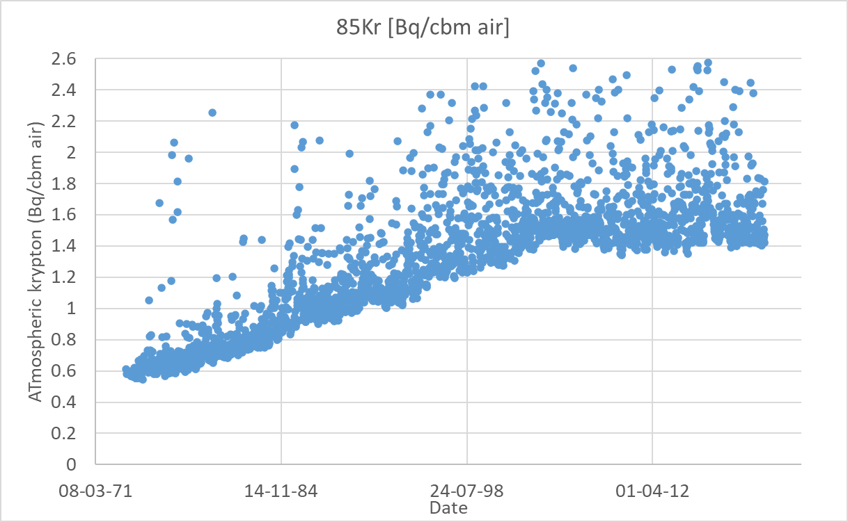
Dataset: input sources
Atmospheric krypton from IAR data (or Kersting et al, 2020, or https://data.mendeley.com/datasets/p32bmw6rgs/1)
(file freiburg_krypton.txt)
Caution: units are Bq/cbm air
(not pptv → correct pyage kr85.yaml )

Slide 9
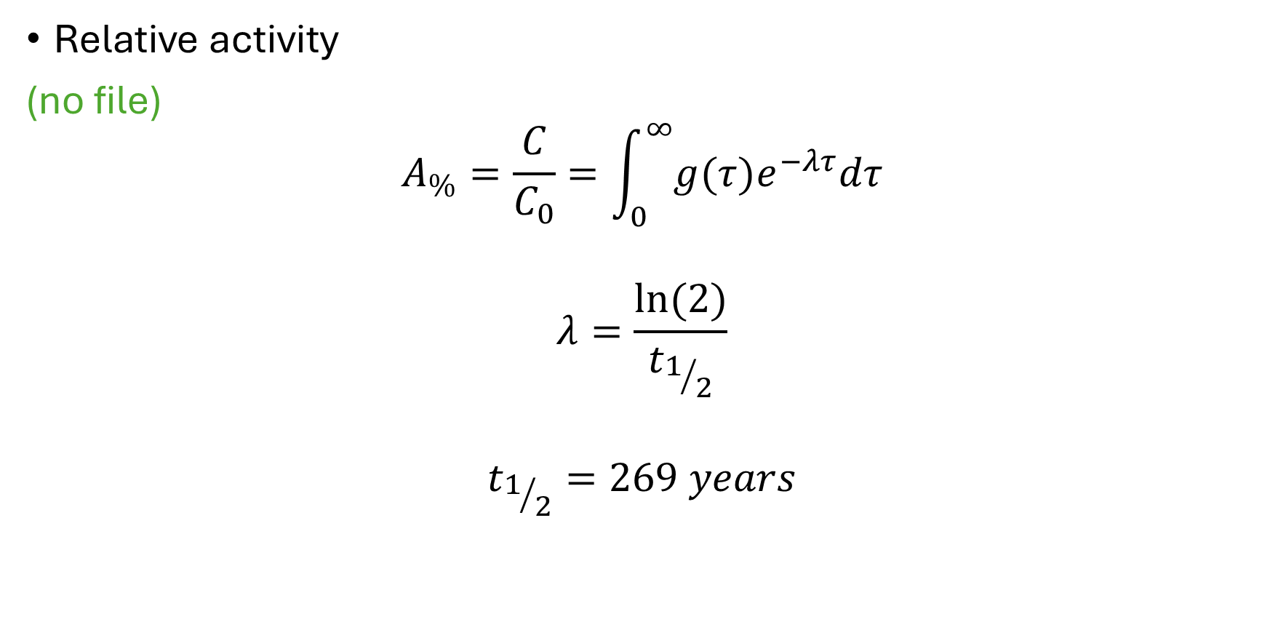
Dataset: input sources
Relative activity
(no file)
$$A_{\%}=\frac{C}{C_{0}}=\int_{0}^{∞}{g(τ)e^{−λτ}dτ}$$
$$λ=\frac{ln⁡(2)}{t_{1/2}}$$
$$t_{1/2}=269 years$$

Slide 10

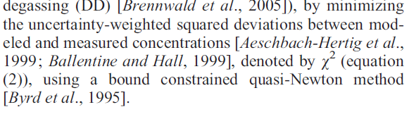
Calibration
Minimize
m: observed
m : modelled
sigma i: uncertainty
Evaluate the p-chi² for each model
Accepted models: p-chi² > 1%

Slide 11
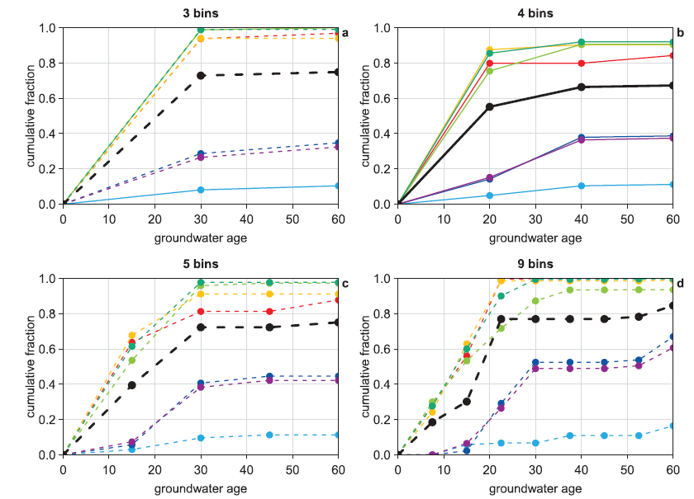
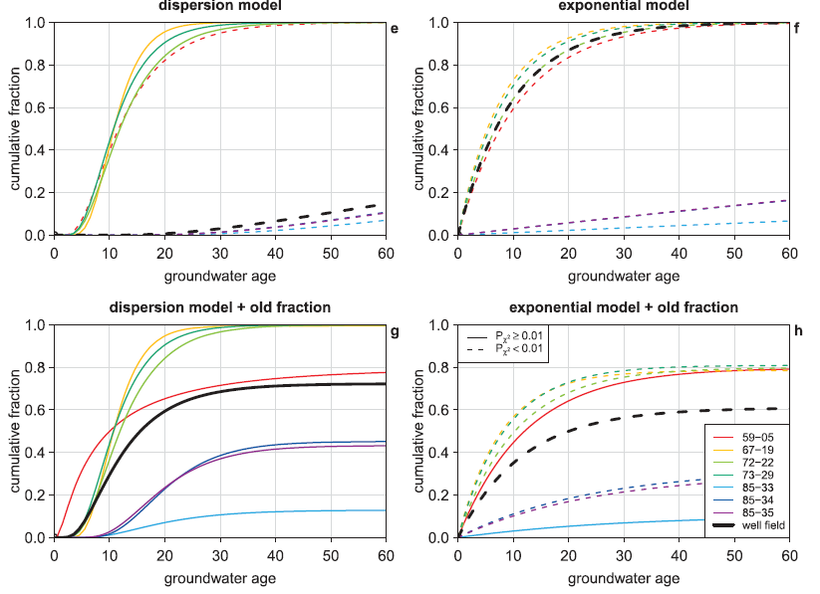
Calibrated cumulative RTD
Rejected
Shape-free
Histogram values picked with starrydigitzer (https://digitizer.starrydata.org/)
(file visser_data.xslx)
Accepted

Slide 12
Calibrated cumulative RTD
Analytical RTD: shape

Slide 13
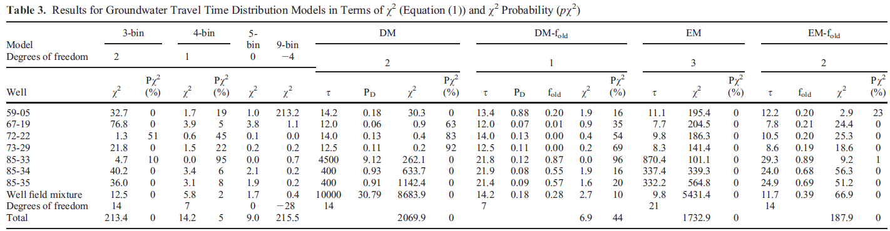
Calibrated cumulative RTD
Analytical RTD: parameters (file calibration_results.txt and visser_data.xslx)

Slide 14

Modifications to carry out in pyage
Change atmospheric krypton units to Bq per m3 air
Krypton data in sampling wells are in dpm/cc
1Bp = 60dpm
1Bq/m3 = 6x10⁻⁵ dpm/cc
Implement additional RTDs
Shape-free missing
Exponential: exp in pyage
Dispersion: ig in pyage
Exponential + old: missing
Dispersion + old: missing
Caution: “old” is the fraction of premodern GW

